Slide 1
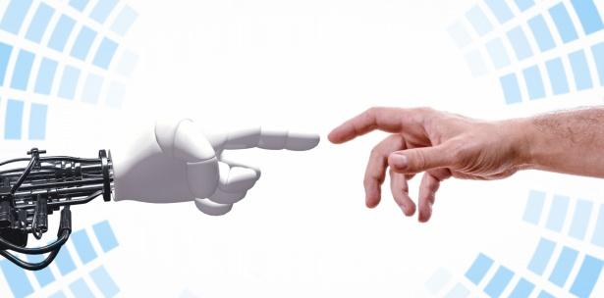
A Scalable Agentic AI for Multi-Modal Video Classification, Summarization, and Analysis
AAI-521 Advanced Multimodal Video Analysis
Gangadhar Singh Shiva | Nagarajan Mahalingam | Akshobhya Rao BV
Team- 3
University San Diego
December 2025

Slide 2
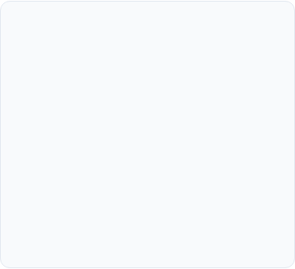
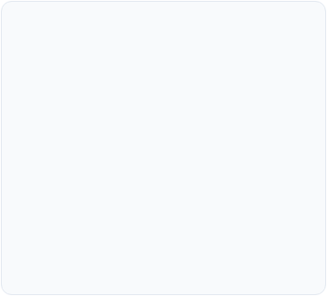


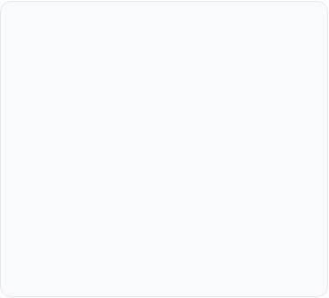

Project Objectives
Optimize Classification and Analysis
Adaptive Workflow
Multi-Modal Resilience
Training - Kaggle Human Action Recognition Dataset
Experiment with ResNet18, fine tuned with Lora for parameter-efficiency and CNN+LSTM+FC Layer for classification
Yolo v8+SSIM - performance video analysis
Design and implement a conditional processing pipeline using LangGraph to manage state and dynamically route tasks based on classification certainty.
Implement auxiliary data retrieval (audio transcription) and logic refinements to maintain quality and guarantee relevant contextual data.

Slide 3
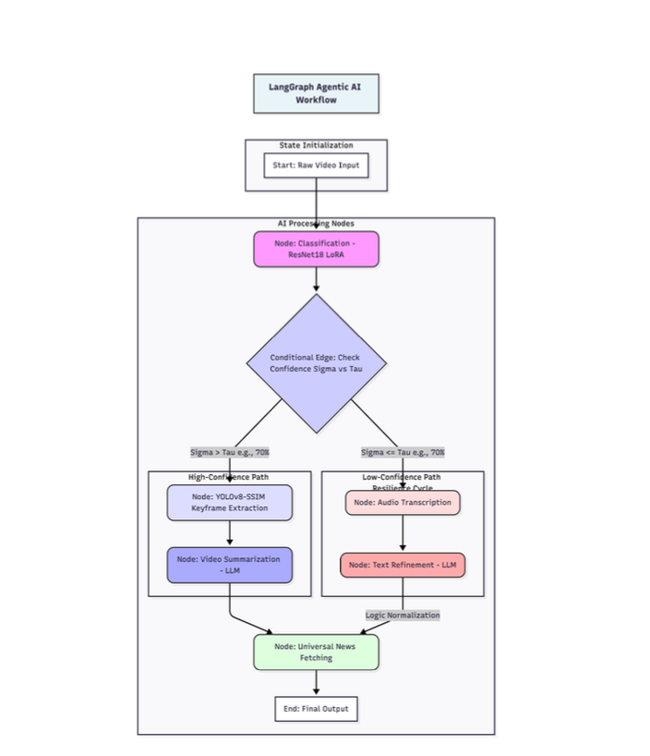
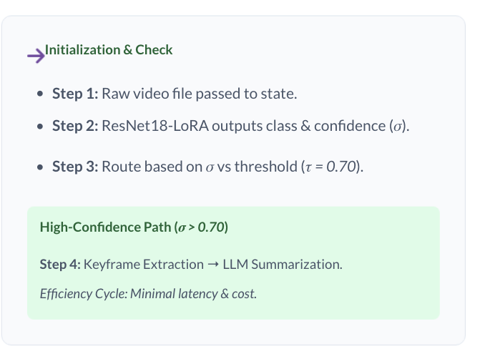
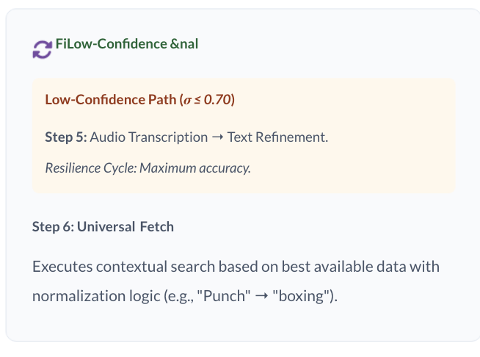
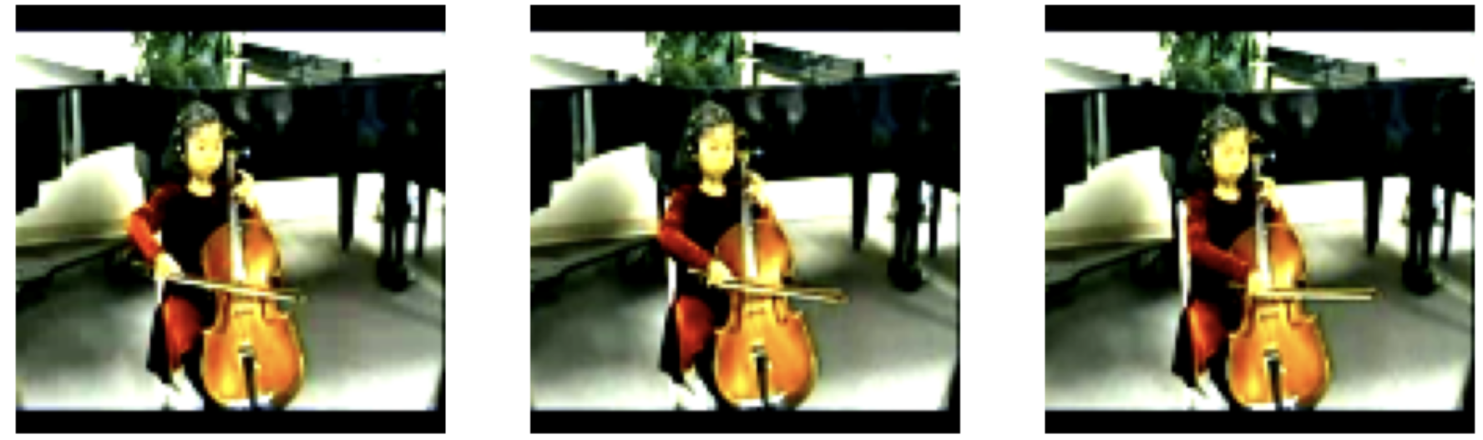
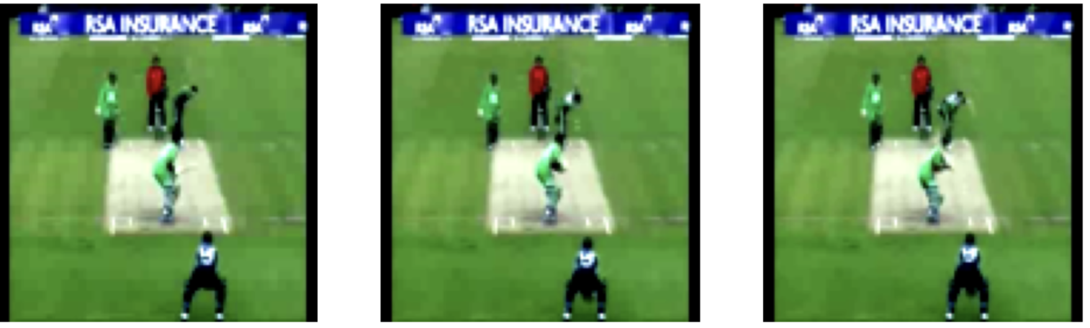
LangGraph Agentic AI Workflow - video analysis

Slide 4
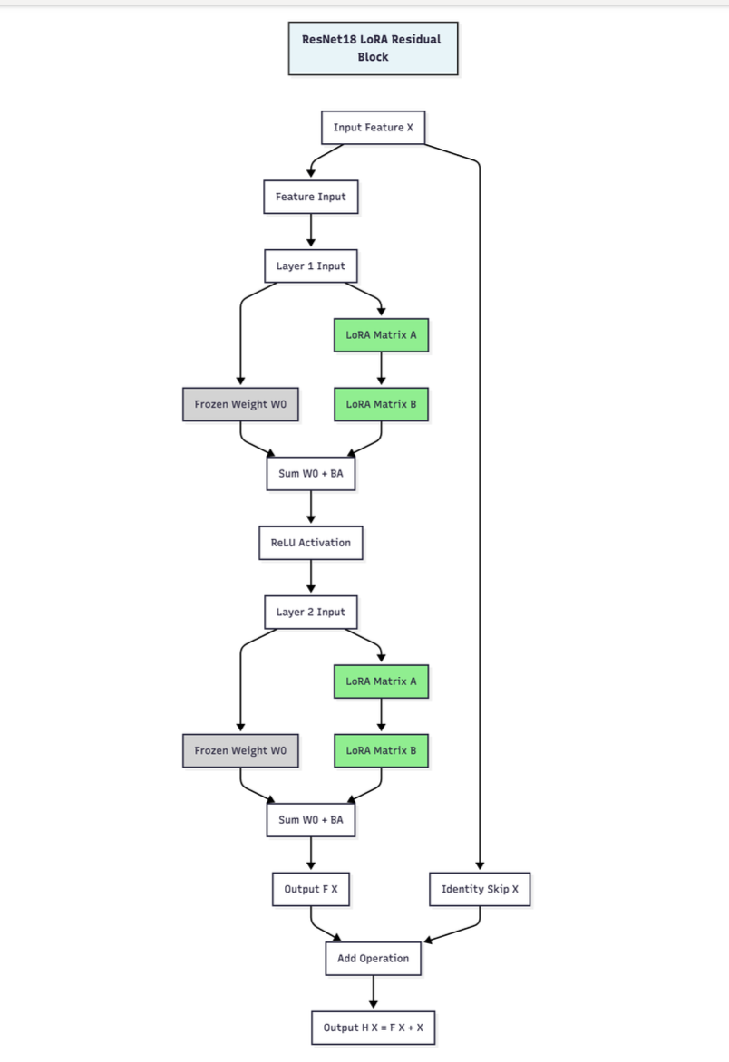
ResNet18+Lora is preferred model for Routing due to high-performance classification, reduced training costs.
Classification Architecture
ResNet18 Backbone
•
Residual connections: H(x) = F(x) + x
•
Pre-trained on ImageNet weights.
LoRA Adaptation
•
Low-rank matrices: W = W₀ + BA
•
Rank r = 4 (Only 0.5% params trainable).
Performance Metrics
Metric | Value
Validation Accuracy | 76..4%
F1 Score | 76.4%
Trainable Params | 0.5%

Slide 5
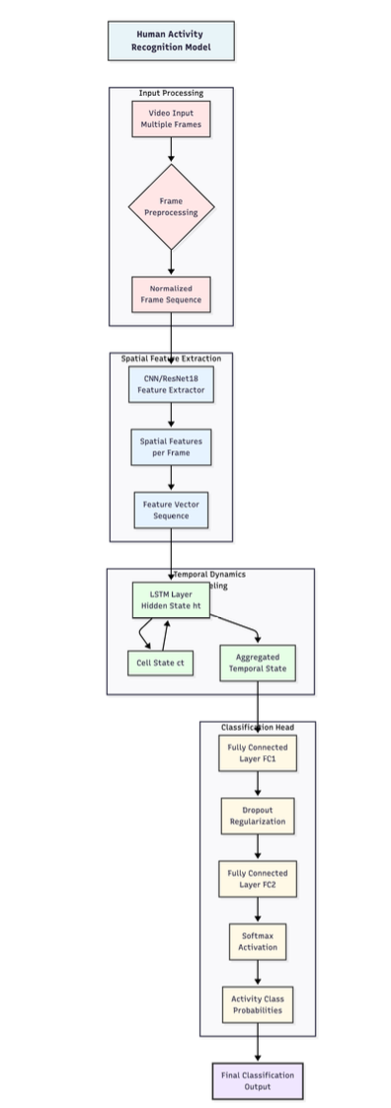
CNN-LSTM-FC Pipeline for Activity Classification
CNN -Spatial
Role: Feature Extraction
Description: Extracts robust feature vectors from each individual video frame.
LSTM -Temporal
Role: Temporal Modeling
Description: Processes the sequence of feature vectors to model dependencies over time.
FC -Classification
Role: Classification
Description: Softmax layer performs final class prediction for the entire activity sequence.
Performance Metrics
Metric | Value
Validation Accuracy | 85.4%
F1 Score | 84.1%

Slide 6

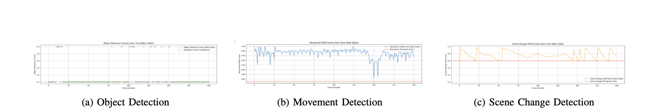
Video Analysis Pipeline
Key Components
YOLOv8n: Real-time identification of human subjects.
SSIM Analysis: Measures visual similarity between consecutive frames.
Dual-Criteria: Select if SSIM ≤ 0.85 AND human detected.
Select Frame and create a highlighted short video.
Extraction Efficiency
•
Target: ≤ 10% of total frames
•
Achieved: 8.7% keyframe rate
•
Result: 91.3% reduction in LLM tokens
YOLOv8 Real-time Identification

Slide 7

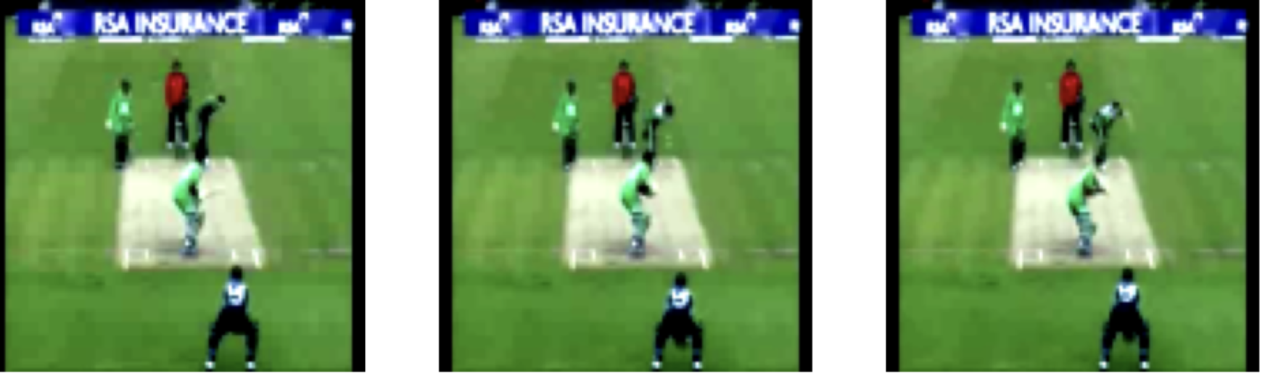
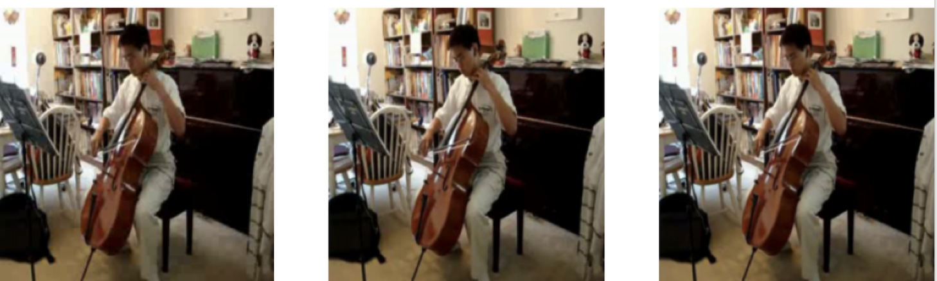
Video Summarization Results
Test Case A: Cricket
Test Case B: Playing Cello
Path: High-Confidence (Efficient)
Path: High-Confidence (Efficient)
Conf: 98.2% | Query: "cricket shot"
Conf: 99.72% | Query: "playing cello"
Action: Keyframe extraction - Successful
Action: Keyframe extraction - Successful

Slide 8

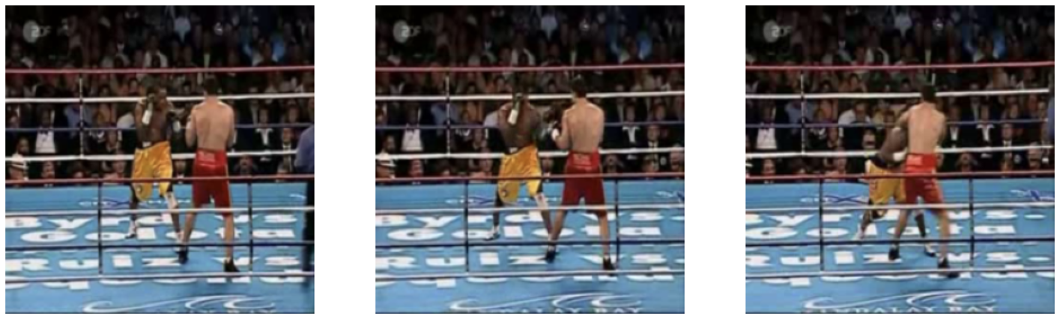

Video Summarization Results
Case D: Punch
Path: Low-Confidence (Resilient)
Conf: 55.7% | Query: "boxing"
Action: Audio Refinement (Normalized) Extraction unsuccessful
Case C: Unknown
Path: Low-Confidence (Resilient)
Conf: 42.0% | Query: "unknown"
Action: Audio Transcription - Extraction unsuccessful

Slide 9







Conclusion
The objectives of creating a robust, adaptive, and modular AI pipeline using LangGraph were successfully met, featuring parameter-efficient fine-tuning and resource-conscious summarization.
Verified Resilience
Efficiency
State-Aware
Performance
91.3% reduction in token consumption.
Reliable operational control for future AI apps.
92.4% accuracy with only 0.5% trainable params.
Multi-modal fallbacks provide comprehensive analysis.

Slide 10


